Slide 1
Becoming part of our
Rialto Markets community

Slide 2
Bringing Private Markets
to the Public
MAKING INVESTMENT
ACCESSIBLE TO EVERYONE
A
regulated Broker Dealer
Notes:
Joel to welcome audience and introduce Shari at this point

Slide 3
ABOUT US
Rialto Markets is the trusted ‘go to’ fully regulated broker dealer empowering companies to raise money through our unrivalled expertise in crowdfunding and institutional investment.
We operate a fully compliant and unique secondary market trading platform for buying and selling shares in private companies.
Our technology empowers direct private capital raises and investments, delivering clarity and simplicity to a complex marketplace.
Notes:
Shari to lead from this point onwards

Slide 4
The problem is there are 27 million private companies
in the US but fewer than 1% are publicly traded at present
Until now, there’s been no established infrastructure or regulated secondary trading platform for high-growth private companies to match that of the public markets, such as the NYSE or the Nasdaq.
This creates a massive opportunity, by empowering investors to reach the other 99% of private companies, not only in the secondary market but in the primary too.
Notes:
Shari to explain primary markets to the audience

Slide 5
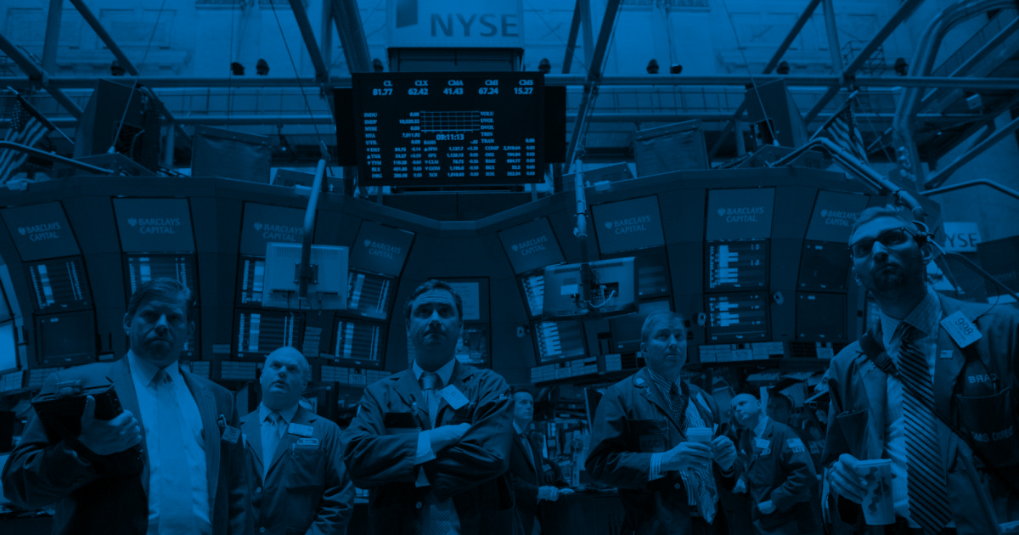
THE PROBLEM
On the days Microsoft, Google and Amazon
launched their stock market IPOs their shareholders
had a 341%, 500% and 3900%
uplift in share value...
...more recent IPOs have not delivered anywhere near in value uplift for it’s shareholders

Slide 6
Trust in the crowd
Notes:
Power of the pack (community of investors) vs a lone wolf (VC)
As an issuer, 15,000 investors provide 15,000 voices/community members and cannot move things for any individual's self interest, compared to one VC member, the power becomes concentrated under one VC and may prove to be detrimental. Establishing a community is a key aim for private companies which is far harder to develop with one VC.

Slide 7
Private Markets lack the infrastructure of Public Markets
THE PROBLEM
Dry Powder grew to a record $2.3 trillion*
68%** of investors cite illiquidity as a pain point
Complexity adds
10-15%*** in cost
Access
Monetization
Complexity
Investors have difficulty identifying and evaluating deal flow.
Issuers have difficulty breaking into and expanding investor networks.
Holding and maintaining assets is manual.
There is an on-ramp into the investment, but no off-ramp to sell and monetize.
Regulatory complexity raises friction.
Paper-based bi-lateral arrangements make standardization difficult.
*McKinsey Global Private Market Review 2020 **Office of the Advocate for Small Business Capital Formation ***JPM, ‘Infrastructure Investing, Key Benefits and Risks’, 2015
Notes:
Explain what Dry Powder is and ensure the audience understand the technical terms throughout

Slide 8
Rialto Markets addresses those friction points with three lines of business
THE SOLUTION
Turnkey infrastructure to conduct a self-hosted capital raise
FINRA approval to transact across private market digital securities
A simple, compliant marketplace solution through ‘Powered by Rialto Markets’
Primary Market
Secondary Market
White Label
Investors can access high growth, early-stage private investment opportunities.
Issuers can reach a diverse investor base, from retail to institutional investors.
Rialto Markets’ Alternative Trading System (ATS) provides an off-ramp to investors looking to monetize.
Issuers can better manage their road to an IPO, offering liquidity events to employees and early investors.
‘Powered by Rialto Markets’ is a cost-effective solution for Crowdfunding portals and fractionalized asset marketplaces.
Industry standard APIs via the FIX protocol and blockchain integration provide for quick implementation and onboarding.
Notes:
White Label definition provided by Shari during this slide

Slide 9
What is an ATS?
Alternative Trading System (ATS) is a regulatory term for a non-exchange trading venue that matches buyers and sellers for transactions. ATS’s are regulated as broker-dealers, rather than as exchanges.

Slide 10
This restricts many prospective investors from investing.
10
Notes:
Meaning investors hesitate to invest due to uncertainty over when they can monetize their investments

Slide 11
What makes our platform technology unique…
POINT OF DIFFERENCE
Reduces friction
Expands access to more potential investors
Lowers the cost of raising capital
Provides investors with access to new opportunities, and
Allows for secondary trading, enabling the private markets to scale.

Slide 12
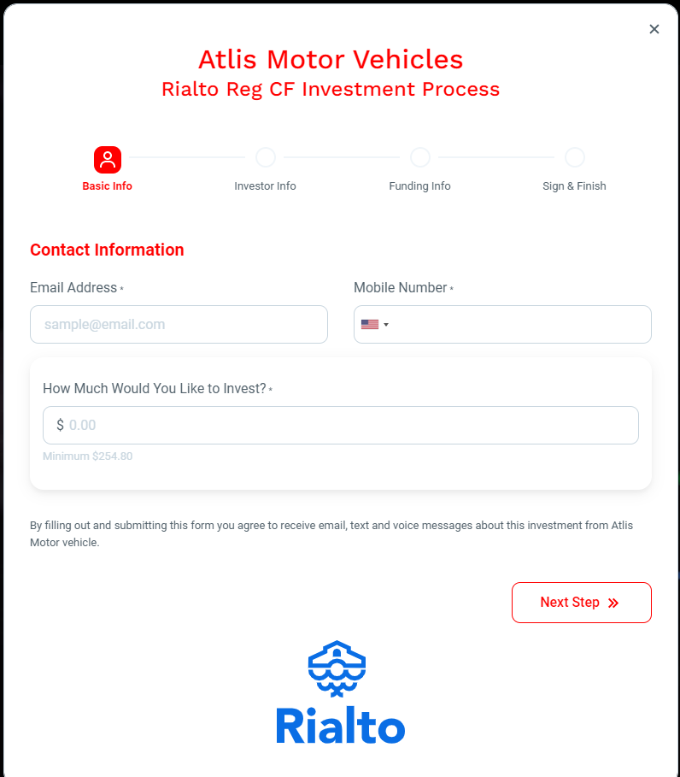
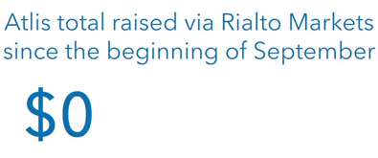
Product Line Drill Down
Primary Market: Infrastructure to support Primary Market Raises
How Rialto Markets Makes Money: Success Fees
Who Pays: The Issuer
Recurring? No
As of 11/02/2021 at 5:30am
Notes:
Shari talks about how much was raised very quickly for Atlis Motors and then talk about how much we are raising for the other eight issuers including $4 million for Cityzenith

Slide 13
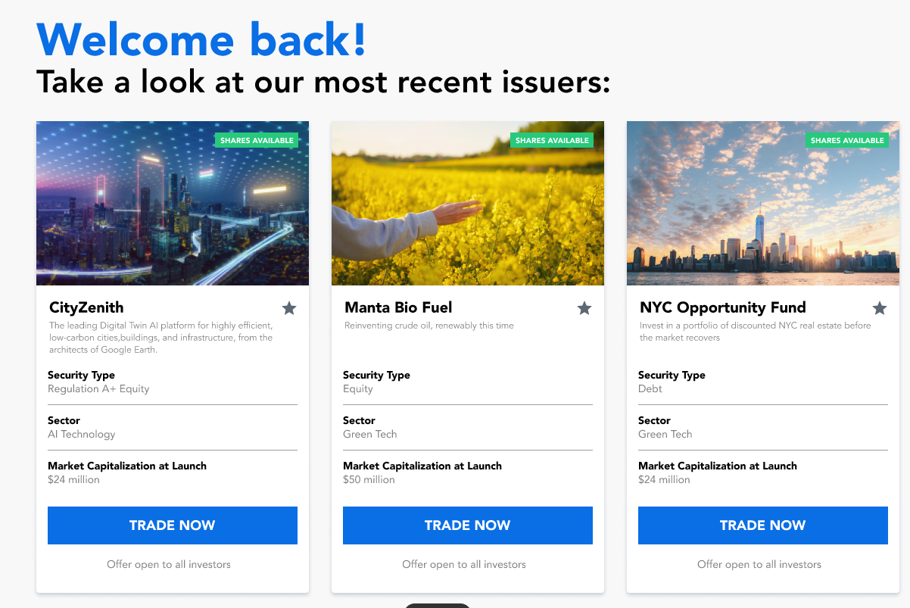
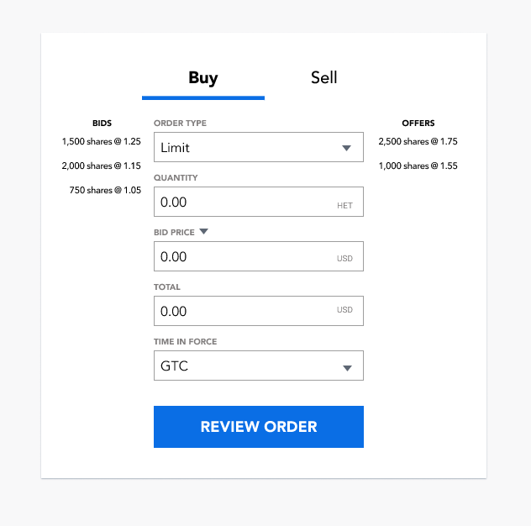
Product Line Drill Down
Secondary Market: Alternative Trading System for US Securities Trading
How Rialto Markets Makes Money: Listing Fees and Commissions
Who Pays: The Issuer (Listing Fees) and the Subscriber (Commissions)
Recurring? Yes

Slide 14
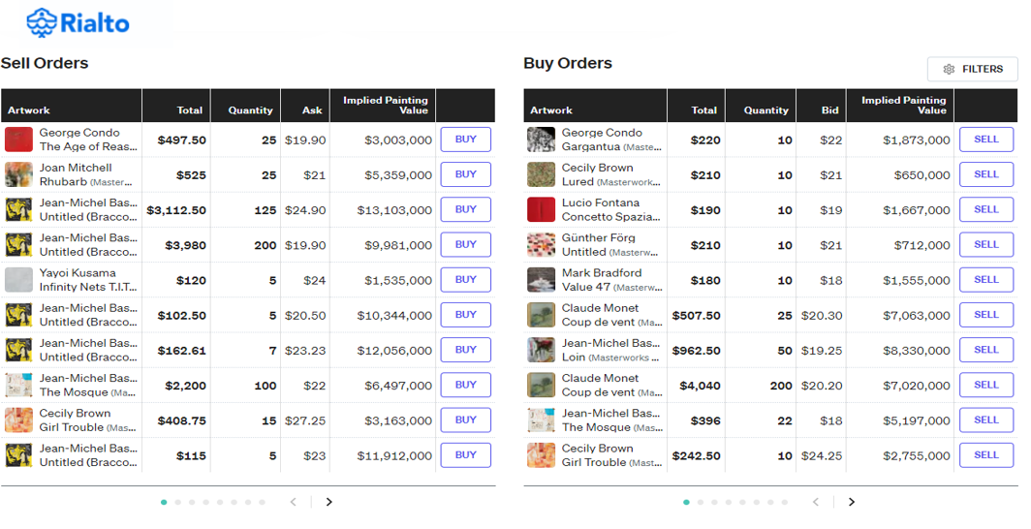
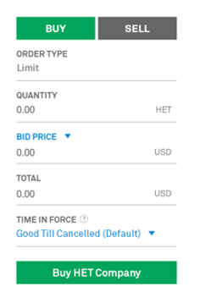
Product Line Drill Down
White Label: ‘Powered by Rialto Markets’
How Rialto Markets Makes Money: Licensing Fee and Commissions
Who Pays: The Marketplace (Licensing Fee) and the Subscriber (Commissions)
Recurring? Yes
Marketplace website
Notes:
This is an important division of Rialto Markets as it has picked up great momentum, because of the significantly increased scrutiny from regulators – therefore people are coming to Rialto Markets

Slide 15
Immediate Future Opportunity in Fractionalized Assets
Rialto Markets’ ATS supports investing and trading in alternative and fractionalized assets
All Money, Real Assets (Digitizable Assets)
Stock Markets
Gold
Market Cap
Bitcoin
Current Use Cases:
Serial Issuer of Artwork
Serial Issuer of Athletic Influencer Companies
~$1T
$12T
$90T
$100’s of Trillions
Assets Currently Unavailable for Investment
Current Investable Assets

Slide 16
BUSINESS MODEL
Our Competitive Edge
For both issuers and investors
Empowers issuers to raise capital and own their data
Allows private companies to retain key personnel
Gives investors wider access to the private markets
FINRA-recognized broker dealer in all 50 states
Connects issuers with a diverse investor base
FINRA-recognized and SEC-qualified alternative trading system (ATS)
Provides a platform for investors to monetize their investment

Slide 17
BUSINESS MODEL
Rialto Markets’ multiple revenue streams
Success fees of 1%-3% for broker dealer solutions on millions of dollars of investment
Success fees of 6-8% from connecting issuers with investment banks and platforms
Commissions on transactions, ranging from 2% to 25 basis points (or 0.25%) of notional value
Recurring revenues from placement and maintenance fees from issuers

Slide 18
Built on Wall Street
regulation and traditions
As this market opens up to more competition, no one has more experience in managing and communicating the regulatory framework than Rialto Markets.
18
Notes:
Shari to discuss the challengers, leaders, niche players & visionaries, as well as what is going to separate the winners in this key market.
Rialto Markets combines a scalable, retail capability that expands the breadth of investors while the rare digital securities mandate extends the depth of potential investments.
You need to know and understand how to manage the regulatory frameworks or you’ll be in hot water

Slide 19
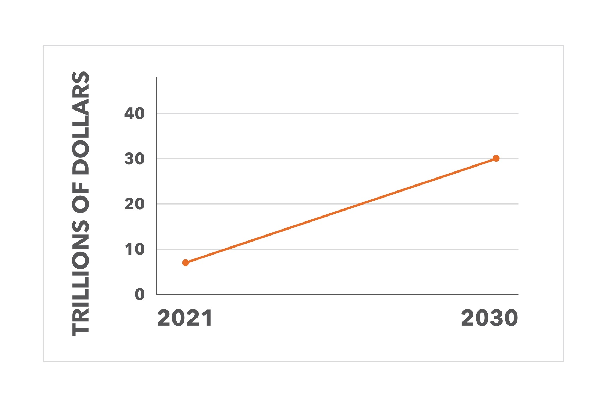
Major Market Growth
The private markets continue to grow rapidly, accounting for $7 trillion in private assets this year, proving that investors support exciting private companies.
$30 trillion
The same Forbes report in 2021 forecasts global Private Equity to reach to grow to $30 trillion by 2030.
$7 trillion
Notes:
At the same time, private companies are largely choosing to stay private instead of raising money via Initial Public Offerings. In 2020, securities offered through Regulation D and Regulation A+ offerings accounted for $1.4 trillion – nearly a third of all capital raised by private companies under SEC regulations (source: Office of the Advocate for Small Business Capital Formation).
Researchandmarkets.com forecast the global crowdfunding market to grow by $196.36bn by 2025 from today
Equity Crowdfunding Week; RegCF and Regulation A+ crowdfunding in the US has more than doubled since the second quarter of 2021 and is expected to be more than 100% up year on year in money invested

Slide 20
BUSINESS MODEL
Rialto Markets Traction & Success to Date
Actively raising $200M+ with a $600M pipeline on our broker dealer primary platform through Rialto Markets’ infrastructure
Received rare FINRA-recognition and SEC-qualification to transact across private market securities in both digital and traditional forms on their alternative trading system (ATS)
Established partnerships with many investment banks, law firms, transfer agents and escrow banks
Successfully launched primary offerings for nine private companies, with 20+ in the pipeline
Built-out infrastructure for both primary raises and secondary offerings

Slide 21
Key to our success is our experienced team
Our team and advisors have been at the heart of the migration from voice to electronic for most asset classes and we are poised to execute the next evolution in capital markets.
Successfully Managed
Shari Noonan
CEO & Co-Founder
Series 7, 14, 24, 57, 63
Joel Steinmetz
COO & Co-Founder
Series 7, 24, 57, 63
Rob Noonan
CMO & Co-Founder
Jim Caboy
CCO
Series 7, 24, 57, 63
Ryan Simmons
Head of Operations
Series 7, 27, 57, 99
Greg Sullivan
Head of Advisory
Series 7, 63
Lee E. Saba
Head of Market Structure

Slide 22
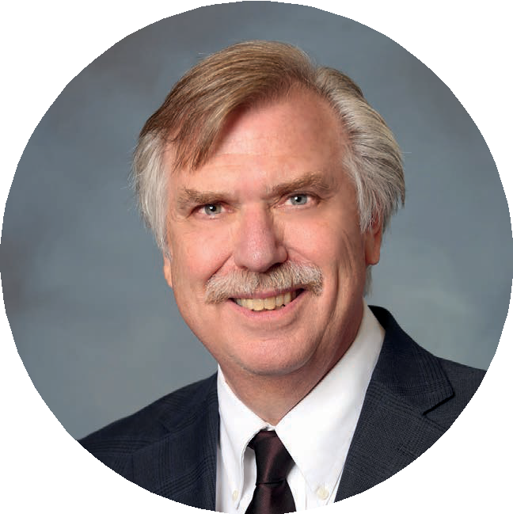
Don’t take our word for it – this is what the market is saying
Rialto Markets is focusing on what I consider to be one of the most exciting parts of the financial industry today, and that is taking equity and debt offerings of private companies and allowing those to be traded on an electronic platform. They will also be helping to unlock private market liquidity for newly created intangible digital assets.
– DR DAVID KRAUSE, DIRECTOR OF MARQUETTE UNIVERSITY’S AIM PROGRAM AND ASSOCIATE PROFESSOR

Slide 23
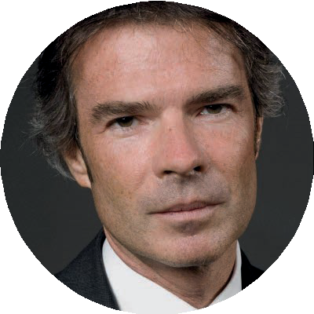
Don’t take our word for it – this is what the market is saying
The key to private equity growth is the booming secondary market
– ANTOINE DREAN FORBES CONTRIBUTOR FOR HEDGE FUNDS AND PRIVATE EQUITY STATS ON GROWTH OF PRIVATE MARKETS

Slide 24
Don’t take our word for it – this is what the market is saying
While public markets have declined as fewer and fewer firms seek a public listing on an exchange due to excessive cost, private markets have boomed. This includes not only securities issued under RegD, available to mainly accredited investors, but also securities available to retail investors issued under RegCF and RegA+.
SOURCE:

Slide 25
This is what exciting private companies have said about Rialto Markets
It always bothered me that my military brothers and sisters couldn't invest alongside me because they didn't have the net worth or income required by the SEC – but, with the help of Rialto Markets these issues have become a thing of the past.
– MISSION FIRST CAPITAL FOUNDER, PHIL CAPRON
Partnering with Rialto Markets to raise this funding so rapidly has enabled ATLIS to now quickly scale battery development and move towards vehicle production. The fast pace and major oversubscription of our most recent raise speaks volumes about the success of our capital raise with Rialto Markets.
– ATLIS PRESIDENT, ANNIE PRATT
We are delighted to be one of the first US companies to offer an ATS to its shareholders. With the help of Rialto Markets, investors in Cityzenith will now no longer necessarily have to wait 3-5 years to access returns.
– CITYZENITH CEO AND FOUNDER MICHAEL JANSEN

Slide 26
We are working towards the launch of a $5 million Reg CF Raise
Capital Raise Details:
$5 million raise
Use of proceeds is to scale operations
56% employees, with hires in operations, business development and technology
19% on technology
15% on marketing
10% on all other administrative, including legal
Rialto Markets’ regulatory approval gives the company a substantial head start to establish a market presence within the digital securities private market ecosystem.
We will shortly be announcing the details of our $5 million Reg CF offering
We will keep you informed after this event on how you can become part of Rialto Markets’ investment community as soon as we have approval

Slide 27
Rialto Markets upcoming investment opportunity
Important Notice
(i) no money or other consideration is being solicited, and if sent, will not be accepted;
(ii) no sales will be made or commitments to purchase accepted until the Form C is filed with the SEC and only through an intermediary’s platform; and
(iii) a prospective purchaser’s indication of interest is non-binding.

Slide 28
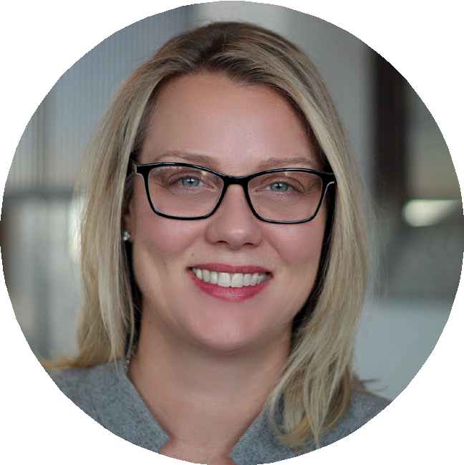
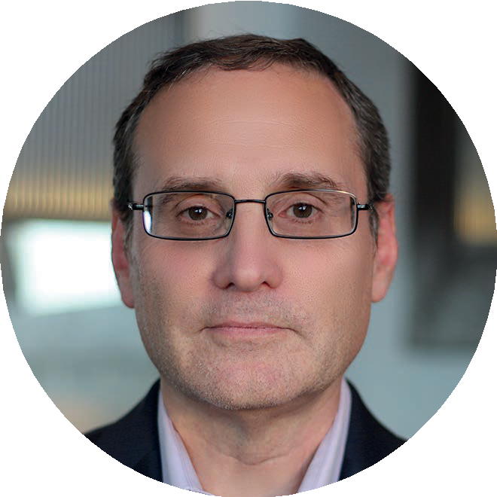
Q&A
Notes:
After the Q&A, Shari to sum up two or three key messages for the audience to keep in mind afterwards, see below:
1. The private securities market is a growing far quicker than any other investment opportunity
2. The private securities market has never been more accessible because of what Rialto Markets are doing
3. The Secondary Market ATS is revolutionising the industry

Slide 29
Thank you for your time today, and we look forward to any further questions or interest you may have.
Email: info@rialtomarkets.com
Website: rialtomarkets.com

